Slide 1
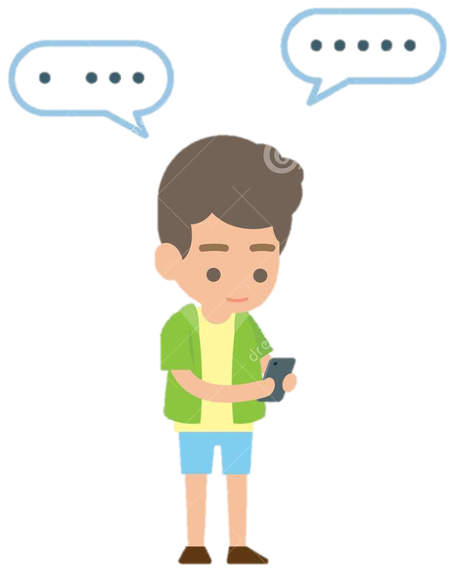


CONVERSATION
Connected by
Technology
Conversation
● Interactive — tap the cards as you go
Start the lesson
Every question in this lesson answers when you tap it.
Notes:
OPENING — 1 min.
Read the title together. The two stickers preview the lesson language (texting abbreviations).
Tap “Start the lesson” (or press →) to move on.
HOW THIS DECK WORKS: nothing is pre-revealed. In the slideshow, answers and feedback are invisible until you tap the matching card — then they fade in on the same slide. In edit view you will see them all; that is normal.
Present in PowerPoint 2019+ / Microsoft 365 so Morph and the click triggers work. Exporting to video plays everything back exactly as it behaves live.

Slide 2

OBJECTIVES
Lesson Objectives
The students will be able to :
1 – Predict the topic of a conversation .
2 – Understand the conversation .
3 – Use some texting abbreviation & Acronym in a text message .
4 – Use the “real talk” phrases in a conversation .
Tick a row once the class has covered it.
5 – Ask for clarifications in a conversation .
Connected by technology
02 / 24
Notes:
OBJECTIVES — 1 min.
Read the five aims. Tap each row as the lesson reaches it — a green tick fades in. Five empty slots give the class a visible sense of progress through the lesson.

Slide 3
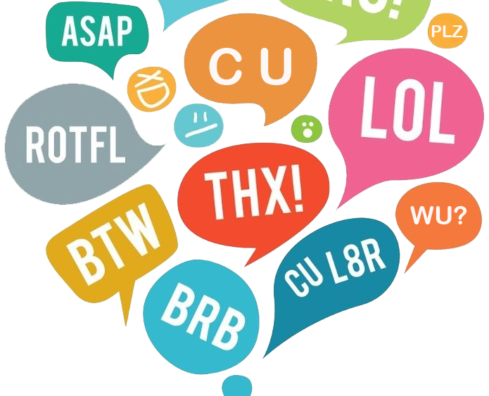
WARM-UP
Is texting a common means of communication ?
YES
NO
texting abbreviations
Show examples
Vote first — hands up for YES, hands up for NO.
Connected by technology
03 / 24
Notes:
WARM-UP — 4 min.
Ask the question and take a quick class vote: tap YES or NO — a tick marks the option that won.
Then tap “Show examples”: the acronym cloud from the original slide appears. The class reads a few aloud. Ask: do you use any of these when you text in Arabic?

Slide 4
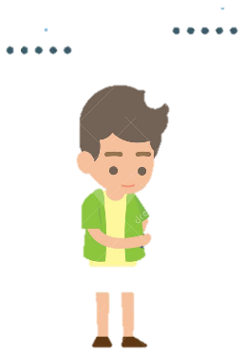
LOOK
WHAT ?
texting
abbreviation
Reveal the words
What can you see?
Say the words before you tap.
Connected by technology
04 / 24
Notes:
LOOK — 2 min.
Ask what the cloud shows. Elicit “texting” and “abbreviation” first; then tap “Reveal the words” to confirm both labels.

Slide 5
THINK
How do people text in your language?
e.g.
PLZ = please
Gr8 = great
B4 = before
How do you shorten words when you text in Arabic? Say two examples, then tap e.g. for three English ones.
Connected by technology
05 / 24
Notes:
THINK — 3 min.
Pair talk first: how do people shorten words when texting in Arabic? Take two examples from the class. Then tap “e.g.” to reveal three English text abbreviations the lesson reuses later (PLZ, Gr8, B4).

Slide 6
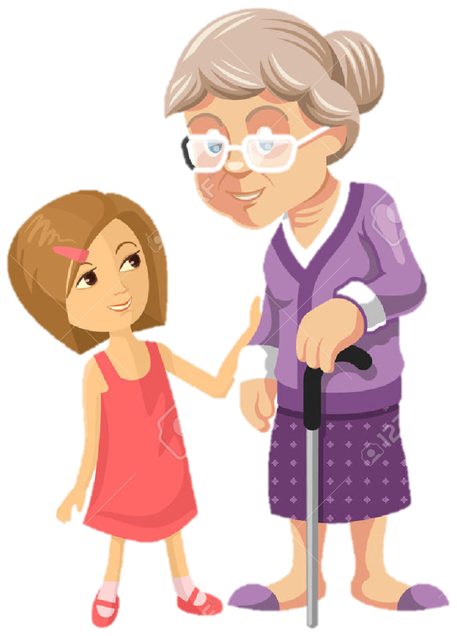

LISTENING
What do you think they are talking about ?
Listen to the audio
football?
….?
Check
Cara is texting Maria.
Grandma · Cara
Guess first, then tap Check.
Connected by technology
06 / 24
Notes:
LISTENING 1 — prediction (4 min).
Tap the round play button to hear the conversation. Before the second listen, ask the class to guess: tap “football?” or “….?” — a tick records which guess the class made.
Then tap Check: the real topic appears under the question.

Slide 7
LISTENING
Listen to the audio
What are they talking about ?
What is the granddaughter’s name ?
Texting — Cara is texting Maria.
Cara.
What is Cara’s friend name ?
What is Cara doing ?
Maria.
She is texting Maria.
What is the sound grandma heard first ?
Does grandma know how to text ?
A beep.
No — Cara shows her how.
Tap a question to check the answer.
Show all answers
Connected by technology
07 / 24
Notes:
LISTENING 2 — comprehension (6 min).
Play the audio again (small play button, top right). Pairs answer, then tap each question card: the answer fades in inside the card that asked it, so the class checks itself.
“Show all answers” reveals the whole grid for a final review.

Slide 8
READ
Listen ‘N’ read
Full script
Grandma: What are you doing, Cara?
NOTICE THESE
Cara: I’m texting Maria. I haven’t seen her all week, so I’m just saying “hi.”
How on earth
Grandma: What’s that beep?
Cara: It’s Maria. She just sent a text message back to me.
Hold on
Grandma: I don’t understand. How on earth do you type what you want to say so quickly?
Cara: You don’t actually type the words out. You use abbreviations and acronyms. Hold on. I’ll show you. Right now I’m asking if she wants to come over and hang out.
hang out
Grandma: That’s a lot to type.
get it
Cara: Right. So instead I type “DYWT come ovr.” Does that make sense?
Grandma: DYWT? What does that mean?
got the hang of it
Cara: DYWT means “Do you want to.” It’s the first letter of each word.
Grandma: Oh. OK. Now what?
These are the phrases we practise all lesson — spot them as you read.
Cara: She’ll respond in a second. (beep) There.
Grandma: What did she say?
Cara: (spelling it out) Gr8. B ovr n 10 mins.
Grandma: I think I get it. She’s saying, “Great. Be over in ten minutes.”
Cara: Now you’ve got the hang of it, Grandma!
Connected by technology
08 / 24
Notes:
READ — 5 min.
Play the audio once more while students follow the script. Then read it in two halves: teacher = Grandma, class = Cara (then swap).
The rail on the right lists the five phrases recycled later; ask students to wave when they hear one.

Slide 9
ABOUT THE CONVERSATION
About the Conversation
In pairs, ask and answer the questions. Then switch roles.
What doesn’t the grandmother understand?
1
What acronym does the grandmother learn? What texting acronyms do you use?
2
Tell your partner about a time you explained something or learned something new from a friend.
Switch roles after every question so both partners ask and answer.
3
Tap a question once the pair has answered it.
Connected by technology
09 / 24
Notes:
TASK CARD — pair work (6 min).
Same instructions as the original slide. Pairs ask and answer; tap a question when the pair is done to mark it.
Q2 has two parts: the acronym grandma learns (DYWT) and the acronyms students use themselves. Q3 opens into a short story — take one or two in open class.

Slide 10
SPEAKING
Role-Play Time
Two roles, one script. Read it, then swap.
Grandma
Cara
What are you doing, Cara?
I’m texting Maria. I haven’t seen her all week, so I’m just saying “hi.”
What’s that beep?
I don’t understand. How on earth do you type what you want to say so quickly?
It’s Maria. She just sent a text message back to me.
That’s a lot to type.
You don’t actually type the words out. You use abbreviations and acronyms. Hold on. I’ll show you. Right now I’m asking if she wants to come over and hang out.
DYWT? What does that mean?
Oh. OK. Now what?
What did she say?
Right. So instead I type “DYWT come ovr.” Does that make sense?
I think I get it. She’s saying, “Great. Be over in ten minutes.”
DYWT means “Do you want to.” It’s the first letter of each word.
She’ll respond in a second. (beep) There.
(spelling it out) Gr8. B ovr n 10 mins.
Now you’ve got the hang of it, Grandma!
Tap a card to reveal that role’s lines — each half of the class reads its own part.
Connected by technology
10 / 24
Notes:
ROLE-PLAY — 5 min.
Split the class in half (or into pairs). Tap a character card: only that role’s lines appear, so each half knows exactly what to read.
Run the whole script once, then tap the other card and swap roles. Keep the audio as a model: play a line, the class repeats it.

Slide 11
VOCABULARY
Language Builder
Tap a word when the class has guessed its meaning.
abbreviation
acronym
Real Talk
a short form of a word
first letters of several words to write a phrase.
Real Talk (phrases)
How on earth? = How is it possible
PLZ
please
OMG
Ohh my God
=
=
Hold on. = Wait a moment.
ovr
over.
DYWT
Do you want to.
hang out = spend time together informally
=
=
get it = understand
Gr8
great
WU?
What’s up?
got the hang of it = started to understand something
=
=
B4
before
B4N
bye for now
=
=
Connected by technology
11 / 24
Notes:
VOCABULARY — 6 min.
Two word families: abbreviations (letters left out) and acronyms (the first letters of several words).
Elicit the meaning first, then tap the card: it appears to the right of the word. The cream box on the right is the original slide’s Real Talk reference — keep it visible, the class will need it all lesson.
Finish by asking for one more example of each from the class’s own texting.

Slide 12
READ AGAIN
Find the phrases in the script
Grandma: What are you doing, Cara?
How on earth
Cara: I’m texting Maria. I haven’t seen her all week, so I’m just saying “hi.”
Grandma: What’s that beep?
Cara: It’s Maria. She just sent a text message back to me.
Hold on
Grandma: I don’t understand. How on earth do you type what you want to say so quickly?
Cara: You don’t actually type the words out. You use abbreviations and acronyms. Hold on. I’ll show you. Right now I’m asking if she wants to come over and hang out.
hang out
Grandma: That’s a lot to type.
get it
Cara: Right. So instead I type “DYWT come ovr.” Does that make sense?
Grandma: DYWT? What does that mean?
Cara: DYWT means “Do you want to.” It’s the first letter of each word.
got the hang of it
Grandma: Oh. OK. Now what?
Cara: She’ll respond in a second. (beep) There.
Grandma: What did she say?
Show all
Cara: (spelling it out) Gr8. B ovr n 10 mins.
Grandma: I think I get it. She’s saying, “Great. Be over in ten minutes.”
Cara: Now you’ve got the hang of it, Grandma!
Tap a phrase — it lights up in the script.
Connected by technology
12 / 24
Notes:
READ AGAIN — noticing (5 min).
Students scan the script for the five phrases. They point, you tap: the line where the phrase appears lights up in the script.
Ask what the phrase means *in that line* before moving on. “Show all” reveals every highlighted line at once.

Slide 13
REAL TALK
Real Talk (phrases)
Tap a sentence when the class has said what the blue phrase means.
How on earth did that happen ?
How is it possible
If you can hold on , I’ll go and get some help .
Wait a moment.
Where do the youngsters hang out ?
spend time together informally
I don’t get it – it doesn’t make sense .
understand
I’ll teach you how to use the program – you’ll get the hang of it after a while.
started to understand something
Connected by technology
13 / 24
Notes:
REAL TALK — 6 min.
Five phrases taken from the audio. Read each sentence with the class, ask what the blue phrase means there, then tap the card: the meaning fades in on the right.
Drill the intonation: “How on earth…” rises; “Hold on” is short and flat.

Slide 14
PRACTICE
Practice Time
Real Talk (phrases)
Tap a frame when the class has finished it.
How on earth can you _____?
My friends and I often hang out at ______.
Hold on a minute. I have to _____.
I don’t get it. Why do you _____?
I finally got the hang of ______.
Connected by technology
14 / 24
Notes:
PRACTICE — 6 min.
Students complete each frame with their own idea (a place, a reason, a name). Take three answers per frame, then tap the card to tick it off.
The five frames recycle all five Real Talk phrases — insist on the full phrase, not just the gap word.

Slide 15
CHECK UNDERSTANDING
True or false ?
Decide in pairs, then tap TRUE or FALSE — and read the line that proves it.
1- The grandmother doesn’t understand how Cara types a text message so quickly .
TRUE
FALSE
TRUE — “How on earth do you type what you want to say so quickly?”
Not quite — listen again.
2- The grandmother learns the acronym, “DYWT,” or “do you want to.”
TRUE
FALSE
TRUE — “DYWT means ‘Do you want to.’ It’s the first letter of each word.”
Not quite — listen again.
Connected by technology
15 / 24
Notes:
CHECK UNDERSTANDING — 4 min.
Both statements are true. Students decide in pairs and justify with a line from the audio.
Tap TRUE to reveal the exact line that proves it; tap FALSE to see a gentle “listen again” prompt.
Nothing is printed on the slide, so the class commits to an answer first.

Slide 16
CLARIFY
Which things would you say when you don’t understand something or want an explanation ?
I don’t understand.
Can you explain it?
How do you…?
What does that mean?
Does that make sense?
I get it.
Tap a phrase: green = it asks for clarification, red = it doesn’t.
Connected by technology
16 / 24
Notes:
ASKING FOR CLARIFICATION — 3 min.
“Which things would you say when you don’t understand something or want an explanation?”
Answers: I don’t understand / Can you explain it? / How do you…? / What does that mean? all ask for clarification. “Does that make sense?” checks your own explanation and “I get it” confirms understanding, so those two are red.
The original slide printed this worksheet with the ticks already filled in; here the ticks only appear when a student commits.

Slide 17
CONFIRM
What do you say when you understand something ?
I don’t understand.
Can you explain it?
How do you…?
What does that mean?
Does that make sense?
I get it.
Tap a phrase: only one of these confirms that you understand.
Connected by technology
17 / 24
Notes:
CONFIRMING — 3 min.
“What do you say when you understand something?” Only “I get it.” confirms; every other phrase asks something.
Push for the full sentence: “Ahaa, I get it now.”

Slide 18
CHECK
What do you say when you want to know if your explanation is clear ?
I don’t understand.
Can you explain it?
How do you…?
What does that mean?
Does that make sense?
I get it.
Tap a phrase: only one of these checks that you were clear.
Connected by technology
18 / 24
Notes:
CHECKING CLARITY — 3 min.
“What do you say when you want to know if your explanation is clear?” “Does that make sense?” asks the listener to confirm. The others ask for information or confirmation of understanding.

Slide 19
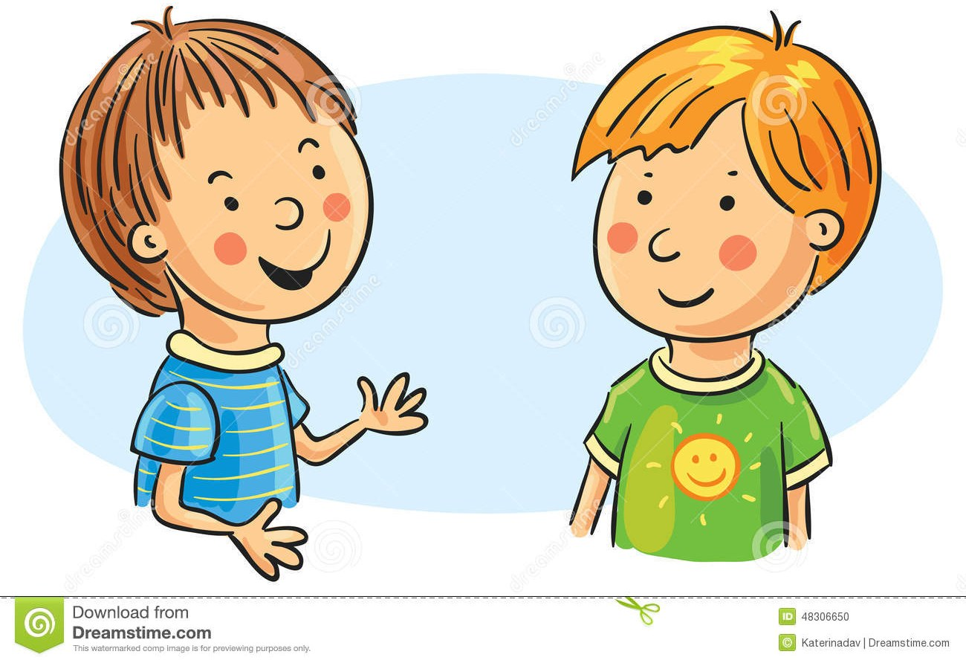
SPEAKING
Talk Time
Create conversations using
phrases from Real Talk
phrases for asking for clarification & confirming
… when you don’t understand
something
… when you understand
something
… when you check your
explanation is clear
Use a Real Talk phrase
I don’t understand.
Can you explain it?
I get it.
Ahaa, I get it now
Does that make sense?
How on earth?
hold on / hang out
Pick a card, then talk for one minute with your partner.
Connected by technology
19 / 24
Notes:
SPEAKING — 8 min.
Pairs. One student taps a task card; the phrase hints appear inside it. They then build a one-minute conversation that must include the phrases.
Circulate, note two strong conversations, and have those pairs perform at the end.

Slide 20
PRACTICE
Choose the suitable phrase
Hi Ali. Let’s ...... in the mall.
hold on
A
Hi Ahmed. OK. I’ll call Faris to meet us there.
Hang out
B
How on earth?
C
“Let’s hang out in the mall” = let’s spend time together there.
Show answer
Tap an option to answer.
Connected by technology
20 / 24
Notes:
CHOOSE THE PHRASE — 3 min.
Read the exchange. Students choose the phrase that fills the gap, then tap an option: green ring + tick for the right one, a red cross for the others.
Answer: “Hang out” — “Let’s hang out in the mall” means let’s spend time there together.

Slide 21

PRACTICE
Choose the suitable phrase
He will send you his place with google map.
get it
A
Yes, I ...............
getting the long of it
B
hold on
C
“Yes, I get it” = yes, I understand.
Show answer
Tap an option to answer.
Connected by technology
21 / 24
Notes:
CHOOSE THE PHRASE — 3 min.
Answer: “get it” (“Yes, I get it” = yes, I understand).
“getting the long of it” is deliberately close to “getting the hang of it” — use it to contrast the two.

Slide 22

PRACTICE
Choose the suitable phrase
............. google maps to me, please?
Does that make sense..
A
Sure
How on earth ..
B
Can you explain..
C
You are asking someone to explain — so: “Can you explain…”
Show answer
Tap an option to answer.
Connected by technology
22 / 24
Notes:
CHOOSE THE PHRASE — 3 min.
Answer: “Can you explain..” — the request that fits “… google maps to me, please?”
“Does that make sense?” checks the listener’s understanding; it does not ask for an explanation.

Slide 23

PUT IT IN ORDER
Put the conversation in the correct order
1
How do you add a picture to Photoshop?
2
Just drag & drop from your files first
3
Great
4
Ahaa, I get it now
Show the order
Tap each message to check its place in the conversation.
Connected by technology
23 / 24
Notes:
ORDER THE CONVERSATION — 4 min.
Pairs decide the order, then tap each bubble: its number fades in at the corner.
Correct order: the question → the instruction → “Great” → “Ahaa, I get it now”.
“Show the order” reveals all four numbers for the whole class.

Slide 24
Thank you!
You have a wonderful day
Connected by Technology · Conversation
Back to the start
Connected by technology
24 / 24
Notes:
CLOSING.
Recap the five objectives in one breath, then send the class off.
“Back to the start” jumps to the title slide, so the deck can be reused with the next class without closing it.

